Slide 1
ENGAGING WITH FOLLOWERS
TASK 3

Slide 2


OBJECTIVE
Define Your Objective Goal: Cultivate a loyal customer base and encourage active participation
2.Focus: Increase brand awareness, boost sales, and build trust through meaningful interactions
.3. Know Your Audience Identify the target demographic (age, lifestyle, preferences).
. Tailor content based on their values, interests, and pain points related to bags and fashion.
Create Interactive ContentPolls & Questions: Use Instagram Stories or Facebook polls to ask your followers about their style preferences, favorite bag features, or upcoming trends
.User-Generated Content: Encourage your followers to share photos with your bags using branded hashtags. Repost their content to show appreciation
.Giveaways & Contests: Offer bags as prizes in a contest where participants tag friends or share your posts.

Slide 3

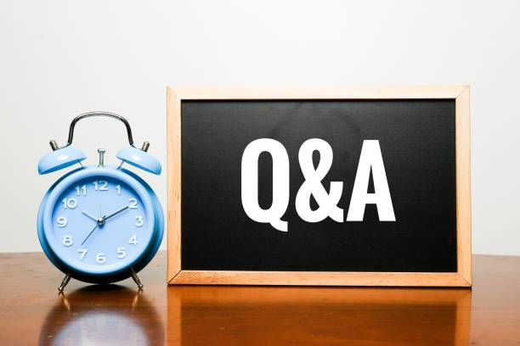
.Respond to Comments & Messages Be prompt and genuine when replying to comments or direct messages
.Use a conversational tone to build relationships. If someone compliments a product, thank them personally.
5. Incorporate Influencers Collaborate with micro-influencers who resonate with your brand image and audience
.Ask them to showcase how they style your bags, offering honest reviews or discount codes to their followers.
6. Host Live Events Live Shopping: Showcase your latest collection in real-time, allowing followers to ask questions and purchase directly
.Q&A Sessions: Go live on Instagram or Facebook to answer questions about your brand, upcoming products, or general fashion tips.

Slide 4
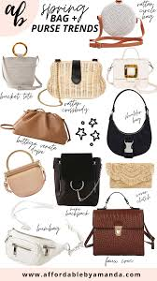
.Build a Community through Stories Share behind-the-scenes moments, production processes, and sneak peeks of new collections.
.Show followers that your brand values transparency and creativity.
8. Reward Loyalty Introduce a loyalty program where frequent customers earn rewards or exclusive offers.
.Share testimonials or highlight your most engaged followers in your stories or posts.
9. Engage in Trending Conversations
Join in on relevant trending topics or fashion challenges to increase visibility.
.Participate in global events like International Women’s Day, with a focus on how your bags empower women.

Slide 5
My bag page review
As per on my page I created poll for bag collection where my followers tell me to launch tote bag collection which has a lot of space as for university and job persons through this we interact with followers know their thoughts for bags what they want in their routine life through this they know more about our page .

